Slide 1

SAP S4 HANA Technical Transformation Project, US/MX Satellites Overview
March 10-14, 2025

Slide 2
US-MX HANA Satellites Overview Introduction
Purpose/questions that will be answered:
What are Satellite systems
Why are we testing
Identify the test phases and the corresponding preparation phases
What is the purpose/reasoning for the various phases
The timing and duration of the phases
What do we need from you

Slide 3
US-MX HANA Satellites Overview Satellite Lead Introduction
Responsibilities
Key activities (high level)
Identify the connected systems/services (aka satellites).
Identify owners, key technical/functional resources and vendors.
Align on priority, criticality, and timing.
Understand the requirements for connectivity such as effort, business data, technical configuration etc.
Test preparation
Ensure services are available for testing as per the agreed schedule.
Ensure services are available for go live as per the agreed schedule.
Provide support during test phases and go live.
Manage assigned defects, ensuring timely resolution and escalate as required.
Minimize impact to business operations.

Slide 4
US-MX HANA Satellites Overview Satellite Overview
What are satellites
Satellite systems are separate, specialized applications that are not part of the core SAP ECC (ERP Central Component) or S/4 HANA system but are integrated with it to handle specific business functions.
Types of satellites
Technical - focuses on the underlying system infrastructure and technical aspects like data management, system administration, and integration
Functional - business-focused components designed to deal with user interaction and address specific business needs like sales, finance, or HR.
What are the different ways satellites interface with SAP
PI/PO (Process Integration/Process Orchestration)
RFC (Remote Function Call)
FTP (File Transfer Protocol)
Flat Files
File Shares
Database access

Slide 5
Project S/4 HANA US & Mexico – Scoping Satellites in scope
Country | US/Mex | US | MX | US | US | US | MX | US | US | US | US | US | US | US/Mex | MX | US | US/Mex | US | US/Mex | US
Satellite Owner(s) | Alastair Kerswell Mritunjay Kumar Saw | Stuart Boyd | Stuart Boyd | Jürgen Mohr Mala Mani Catherine Alberni | Stuart Boyd | SRM Team | SRM Team | Sunil N Subeydhi | Kevin Schmalz | Nathusingh Rathod Vendor support | Brendan Farthing | Armin Pfeiffer Martin Gall | Jim Hardenbrook | Anders N Eriksson Stuart Boyd | Juan Romero | Nathusingh Rathod | Shweta Chaudhary Balaji Soundarrajan | Peter Casazza Patricia Clarke Lisa Moralez | Peter Kerschl Tomas Boldizar | Mark Mezera
Satellite applications | Archive: IXOS/Opentext | Banking: BOA Banking: JPM | Banking: CITI | BW | Data Warehouse Extracts (FTP from SAP) | EDI | EDI: Grainer MX Orders | EDI: LGE Electronics Delivery Advice | Evolve | Extreme | Fiori BTP (Custom) | Global Trade System (GTS) | Perceptive Content | Promethus | RPA | Spectra | SRM | TLIMS | UC4 | Vertex
Interface | SAP PI/PO, RFC, FTP, Flat file, DB Access
Core systems | SAP S/4 HANA

Slide 6
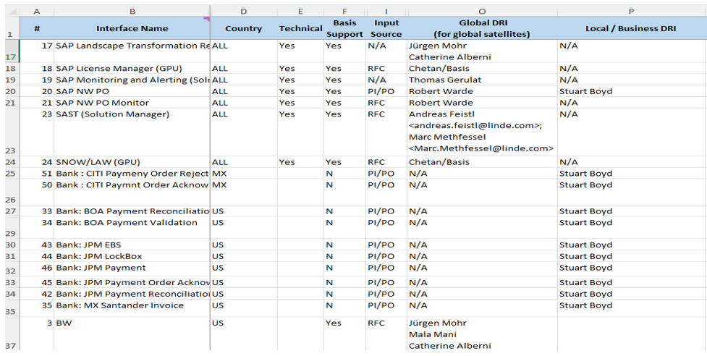
US-MX HANA Satellites Overview Master List
Sample only shown here,
exhaustive list stored in link referenced
Refer to the RNA_interface list.xlsx for satellite information

Slide 7
US-MX HANA Satellites Overview Considerations
Information needed for the satellites
Identify the satellites that are in use
Identify the type, technical or functional
Identify the satellites that are in scope with each phase of testing
Identify key individuals
Functional Expert(s)/Technical Expert(s)/Business owner/Expert User(s)
Resources required to connect
Technical Accounts
End User Accounts
File Shares
Software Packages
Platform capability:
Compatibility - does it support S/4? Will it support S/4? Do we need to upgrade or install a package to make it compatible?
Licensing - can it connect to additional systems?
Support – Do we have a support agreement with the vendor
Capability – Can it connect to multiple systems at once or will we need to switch during testing
Documented processes to connect, configure and test

Slide 8
US-MX HANA Satellites Overview Environments/Test Phases
Shell Testing on Development S/4 environment
Subset of satellites connected to the permanent development S/4 client.
Very limited data, short test period.
This is to confirm the system is setup correctly, that the core business processes are working and that the satellite applications are connected and able to interface with S/4 HANA.
Testing owned by Corp IT, supported by regions
FUT – Functional Unit Testing on Development S/4 environment
Satellites connected to the permanent development S/4 client. Limited data, longer test period.
Unit test the subset of satellites connected. Test the individual system components. Identify and fix fundamental issues.
Testing by Regional IT - Functional, supported by Regional Technical and Corp IT - Functional/Technical teams
TM0 Unit Testing – Functional Unit Testing on migrated TM0 environment
First migration, data possibly not fully suitable for integration, with no satellites connected to temporary test S/4 client
FUT testing with the first migrated data
Testing by Regional IT - Functional, supported by Regional Technical and Corp IT- Functional/ Technical teams

Slide 9
US-MX HANA Satellites Overview Environments/Test Phases
SIT - Systems Integration Testing on migrated TM1 environment
Satellites connected to a temporary quality S/4 client, copy of production data.
Confirm all satellites, functional and end to end business process are working.
Testing by Regional IT - Functional, supported by Regional Technical and Corp IT - Functional/ Technical teams
UAT – User Acceptance Testing on migrated TM2 environment
Satellites connected to the permanent quality S/4 client , copy of production data.
Verify all the end to end business processes are functioning according to specifications.
Testing by Regional Business, supported by Regional and Corp IT - Functional / Technical teams
GLS – Go Live Simulation on migrated GLS environment
Some satellites connected to a temporary quality S/4 client , copy of production data. Health checks (only)
Checks by Regional IT - Functional, supported by Regional Technical and Corp IT - Functional/ Technical teams
Cutover – Go Live on S/4 Production environment
All satellites connected to the permanent production S/4 client , full production data
Health checks (with selective tests) by Regional IT - Functional and possibly key business users
Supported by Regional Technical and Corp IT - Functional/ Technical teams

Slide 10
US-MX HANA Satellites Overview Timeline
2024
2025
2026
Dec
Jan
Feb
Mar
April
May
June
July
Aug
Sep
Oct
Nov
Dec
Jan
Feb
March
April
Test Phases – Red Boxes
Data Migration – Yellow Boxes
System Preparation – Green
Project Start
Go Live
Mobilization
Analyze &
Design
Develop
Testing
Cut Over
Hypercare
Project
Archiving
Archiving execution
Soft Freeze
Change Freeze
Archiving completed
Functional Unit Testing
TM0 Unit Test
Development
&
Functional
Build & Config & Unit Testing
Cut Over Prep
3 Weeks
Interface Planning
Hypercare
Create Test Strategy & Plan
8 Weeks
9 Weeks
Dress Reh
Project Management (Financial, Gov)
Test Automation Build
SIT
UAT
Kick Off
8 Weeks
Functional Data Val.
6 Weeks
Functional Data Validation
11 Weeks
2 Weeks
SDT
SDT MBP
TM1
TM2
GL Sim
Onboarding & Plan
TM0
6 Weeks
6 Weeks
System
build
TM0, SRC1
12 weeks
TM2, SRC1
15 Weeks
GLS (T8A)
TM1 (T8A), SRC2
production P2A
DR
Analysis
Dashboard analysis & configure
Reporting
BW Queries & S4 HANA Gap analysis & build
Local extractor analysis & build
Related Projects
xyz
SAP
Authorization
Single Role Design
Single Role Build
Mapping EU
Job/Composite Role Design
Job/Comp. Role Build
EU Simulation
# Refer to the SAP S4 US & Mexico Project Governance.pptx for the Project plan.
Development
Dual Maintenance
Change Mgt.
Approach
Build Training Material
Train-the-Trainer
Prep
EU Training
Vacation period
Regional
Corporate

Slide 11
US-MX HANA Satellites Overview Possible Limitations
Satellite Test systems not always available, especially when dealing with third parties such as banks, customers or suppliers .
Some tests may have to be simulated and/or involve comparisons of results with ECC.
Where satellite owners reside outside regional/corporate IT, early alignment and commitment of support needs to be ensured
Some satellites can only support one test environment and must be switched between systems.
There may be some different setups or the way some satellites are used between regions.
Connected systems may be required for production support or business critical enhancements. Testing needs to be planned accordingly.
Prioritize satellites applications relating to cutover.
All involved must have a clear understanding of configuration/setup. Ensure documentation, functional/technical resources and, if required, suppliers are available.

Slide 12

Thank you for your attention.

